Slide 1

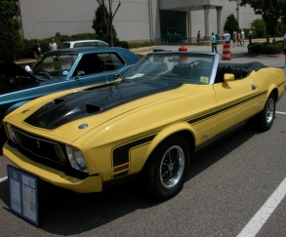

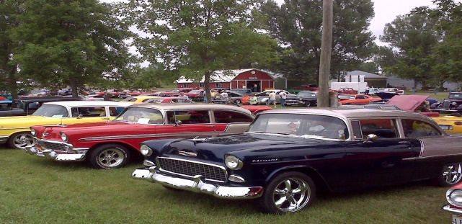

August 15, 2026*
10 am -2 pm
Free admission for all classes of show vehicles
First 50 entries receive a T-shirt and Dash Plaque
$5/ person spectator fee
Maitland Fire Department Auxiliary
Car Show
Music
Location: Riverview Herbs
8907 Hwy. 215, Maitland, NS
BBQ
* Rain date August 16,2026 – 10 am -2 pm

